Slide 1
Customer Stroke Prediction Analysis
Satya Dananjaya

Slide 2



Presentation overview
Data Exploration & Cleaning
Model Development
Prediction Analysis

Slide 3
introduction
The Stroke Prediction dataset will serve as an example how a machine learning model to conduct predictive analysis
Focus of the model : predict whether the patient has stroke or not
Dataset Link

Slide 4
use case summary
Objective statement:
Success criteria
Machine learning enables decision makers to predict customer whether he/she has stroke based on dataset
The evaluation metric that will be used is AUC ( area under ROC curve).
Build ML models that can accurately predict whether customer is stroke or not
Challenges
CUSTOMERS
Large size of data, cannot maintain by excel spreadsheet
Demography data have a lot missing values
25% increase of buildings that are energy efficient proves that there's consumer interest for more green building design
Methodology / Analytic technique
Expected outcome
Descriptive analysis
Graph analysis
ML models
ML models will predict whether patient is stroke or not

Slide 5
Model understanding
ML enables decision makers to predict patient whether is stroke or not by using datasets

Slide 6
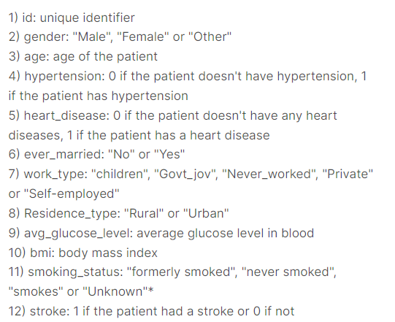
Data dictionary

Slide 7



Data preparation
Jupyter notebook
Importing dataset
Inspect condition data
Pandas
Numpy
Sklearn
Seaborn

Slide 8
Data cleansing
Missing and duplicate values checking and handling

Slide 9
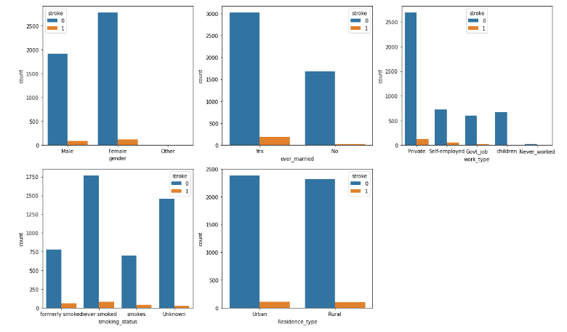
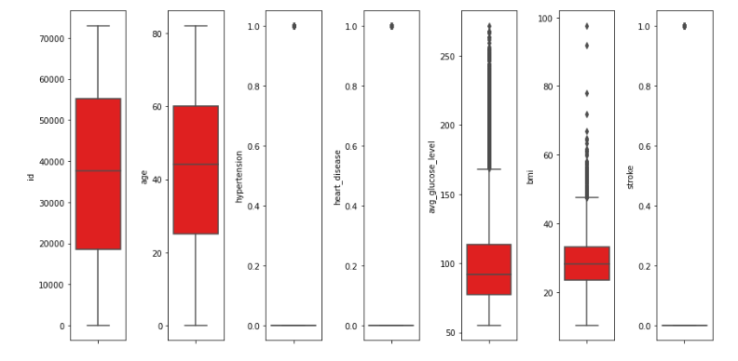
Exploratory data analysis
Data distribution and value counts for the various categorical and numerical variables
Boxplot to detect outlier
Categorical features

Slide 10
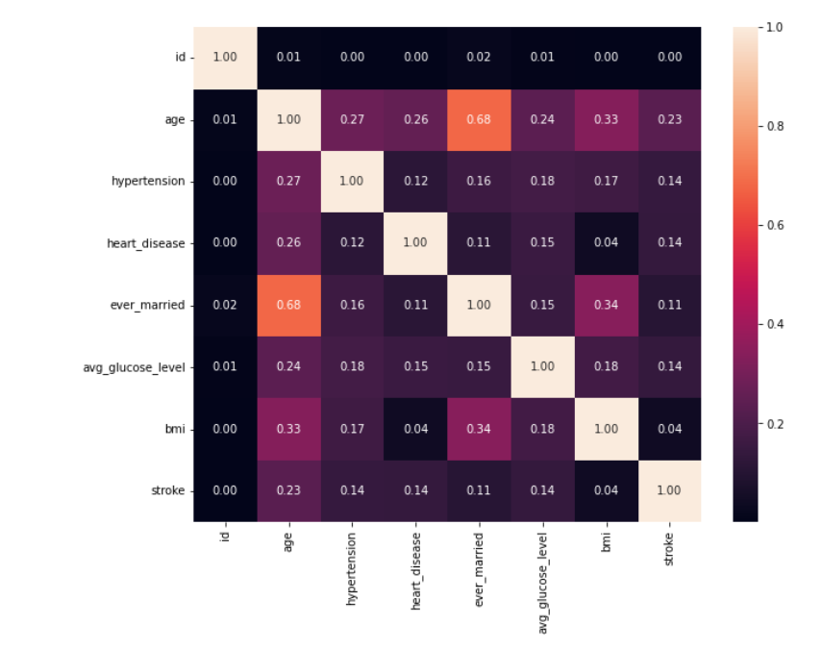
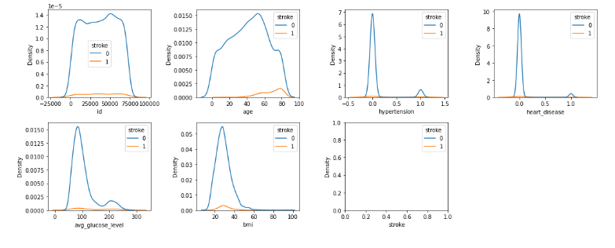
Heatmap correlation
Numerical features

Slide 11
modeling
Split the data into train and test with test size of 30%
Tried 4 different models
Evaluated them using AUC (Area under ROC Curve)
Choosing AUC because its easy interpret model performance

Slide 12
Models
Linear regression
Decision tree
Random forest
XGboost

Slide 13
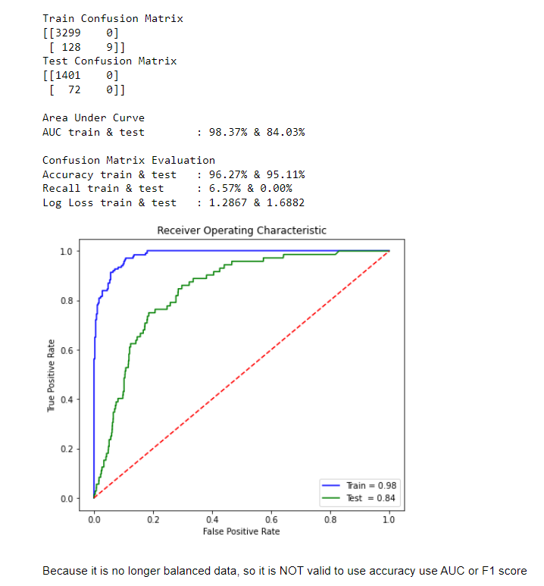
evaluation
Evaluation model used in this project is AUC (Area Under ROC Curve).
The random forest model has best performance among three other models on the test and validation sets.

Slide 14
summary
ML enables decision maker to predict patient using datasets
Evaluation model used in this project is AUC (Area Under ROC Curve).
3 different model has been tried, Linear regression, Decision tree, Random forest and XGboost
The random forest model has best performance among three other models on the test and validation sets.

Slide 15
THANK YOU
Satya dananjaya
DS 16
Dibimbing.id

